Slide 1

The Power of SPA
#PGGD26 – 23/04/2015
Mónica Rodrigues
https://github.com/monica85rodrigues/PGGD26

Slide 2



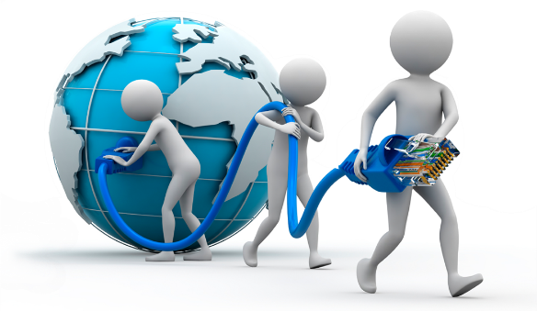



Me?
Since 2010
Mónica Rodrigues
monica85rodrigues@gmail.com

Slide 3
Contents
Challenge
Solution
Motivations
Considerations
SPA Samples
Demos
References

Slide 4
Challenge
Users want a central place to view or take actions on most or all content so they don’t have to waste time navigating between pages.

Slide 5

Solution
Go to a SPA

Slide 6
Solution
Use modern web development techniques to build a single-page app that doesn’t need to reload itself as the user browses through it.
SPA
Single Page Application

Slide 7
Motivations
The 3 Rs
Reach
Web app may be accessible on different platforms and devices
Responsive
Web app needs to be very responsive to different screen resolutions
Round Trip
Web app does not require many round trips between client and server

Slide 8
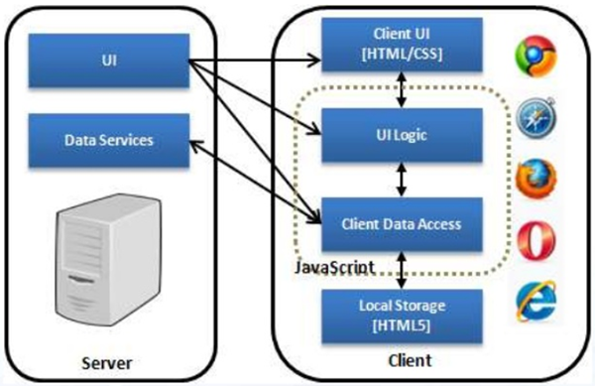
Motivations
Better user experience
Separation of responsibilities between client and server
Offline Web applications

Slide 9
Considerations
The first time that the applications loads is slow
Security
What is the effort to make an offline application? It is possible?

Slide 10
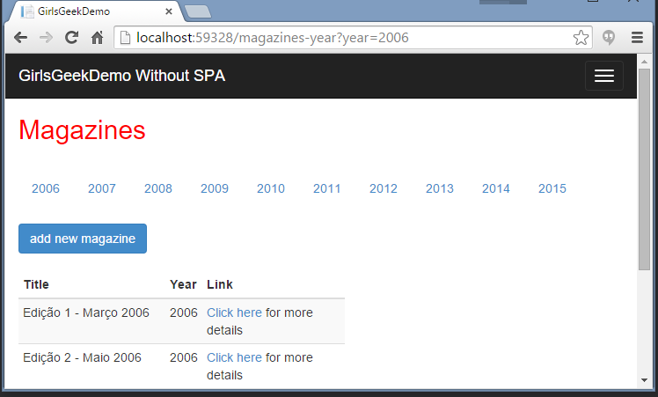

Multiple Page Application
Page access
Page rendering
Returns rendered page

Slide 11
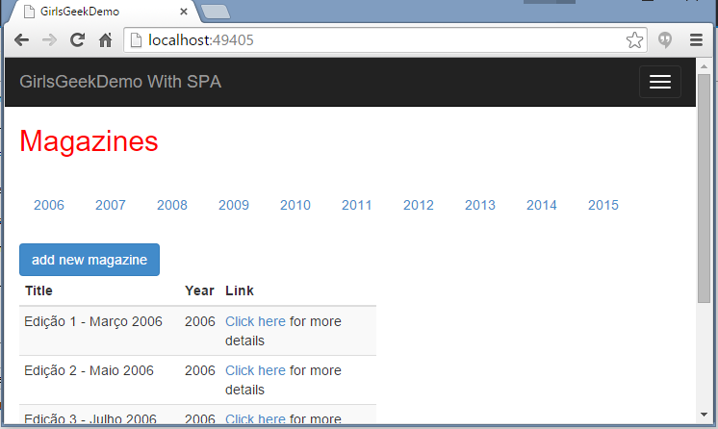
SPA
Requests data
DOM processing and manipulation
Returns data

Slide 12




Some Javascript Frameworks

Slide 13




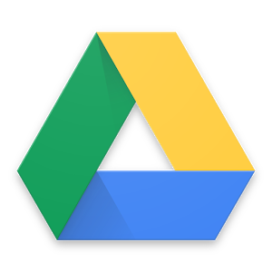


SPA Samples

Slide 14
Demos

Slide 15
References
Angular VS Knockout [Online] http://blog.scottlogic.com/2014/07/30/spa-angular-knockout.html
Angular [Online] https://angularjs.org/
Knockout.js [Online] http://knockoutjs.com/
Backbone.js [Online] http://backbonejs.org/
React [Online] https://facebook.github.io/react/
Code School [Online] https://www.codeschool.com/

Slide 16


Slide 17




Contacts
https://www.linkedin.com/in/monicascrodrigues
https://github.com/monica85rodrigues
https://www.facebook.com/monica85rodrigues
@Monica85Rodrig

